Slide 1
The future of column-oriented data processing with Arrow and Parquet
Jacques Nadeau, CTO Dremio, VP Apache Arrow
Julien Le Dem, Principal Architect Dremio, VP Apache Parquet

Slide 2
Jacques Nadeau
@intjesus
Julien Le Dem
@J_
CTO of Dremio
Apache member
VP Apache Arrow
Apache PMCs: Arrow, Calcite, Drill, Incubator
Principal Architect at Dremio
Formerly Tech Lead at Twitter on Data Platforms.
Creator of Parquet
Apache member
Apache PMCs: Arrow, Incubator, Kudu, Pig, Parquet

Slide 3
Agenda
Community Driven Standard
Interoperability and Ecosystem
Benefits of Columnar representation
On disk (Apache Parquet)
In memory (Apache Arrow)
Future of columnar

Slide 4
Community Driven Standard

Slide 5
An open source standard
Parquet: Common need for on disk columnar.
Arrow: Common need for in memory columnar.
Arrow building on the success of Parquet.
Benefits:
Share the effort
Create an ecosystem
Standard from the start

Slide 6
The Apache Arrow Project
Calcite
Cassandra
Deeplearning4j
Drill
Hadoop
HBase
Ibis
Impala
Kudu
Pandas
Parquet
Phoenix
Spark
Storm
R
New Top-level Apache Software Foundation project
Announced Feb 17, 2016
Focused on Columnar In-Memory Analytics
10-100x speedup on many workloads
Common data layer enables companies to choose best of breed systems
Designed to work with any programming language
Support for both relational and complex data as-is
Developers from 13+ major open source projects involved
A significant % of the world’s data will be processed through Arrow!

Slide 7
Interoperability and Ecosystem

Slide 8
Shared Need => Open Source Opportunity
“We are also considering switching to a columnar canonical in-memory format for data that needs to be materialized during query processing, in order to take advantage of SIMD instructions” -Impala Team
“Drill provides a flexible hierarchical columnar data model that can represent complex, highly dynamic and evolving data models and allows efficient processing of it without need to flatten or materialize.” -Drill Team
“A large fraction of the CPU time is spent waiting for data to be fetched from main memory…we are designing cache-friendly algorithms and data structures so Spark applications will spend less time waiting to fetch data from memory and more time doing useful work” – Spark Team

Slide 9
High Performance Sharing & Interchange
Before
With Arrow
Each system has its own internal memory format
70-80% CPU wasted on serialization and deserialization
Functionality duplication and unnecessary conversions
All systems utilize the same memory format
No overhead for cross-system communication
Projects can share functionality (eg: Parquet-to-Arrow reader)

Slide 10

Benefits of Columnar formats
@EmrgencyKittens

Slide 11
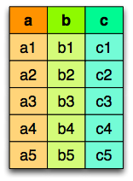

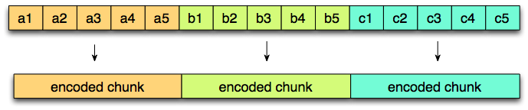
Columnar layout
Logical table
representation
Row layout
Column layout

Slide 12
On Disk and in Memory
Different trade offs
On disk: Storage.
Accessed by multiple queries.
Priority to I/O reduction (but still needs good CPU throughput).
Mostly Streaming access.
In memory: Transient.
Specific to one query execution.
Priority to CPU throughput (but still needs good I/O).
Streaming and Random access.

Slide 13
Parquet on disk columnar format

Slide 14
Parquet on disk columnar format
Nested data structures
Compact format:
type aware encodings
better compression
Optimized I/O:
Projection push down (column pruning)
Predicate push down (filters based on stats)

Slide 15
Access only the data you need
Read only the data you need!
Columnar
Statistics

Slide 16
Parquet nested representation
Borrowed from the Google Dremel paper
Columns:
docid
links.backward
links.forward
name.language.code
name.language.country
name.url
https://blog.twitter.com/2013/dremel-made-simple-with-parquet

Slide 17
Arrow in memory columnar format

Slide 18
Arrow goals
Well-documented and cross language compatible
Designed to take advantage of modern CPU characteristics
Embeddable in execution engines, storage layers, etc.
Interoperable

Slide 19
Arrow in memory columnar format
Nested Data Structures
Maximize CPU throughput
Pipelining
SIMD
cache locality
Scatter/gather I/O

Slide 20
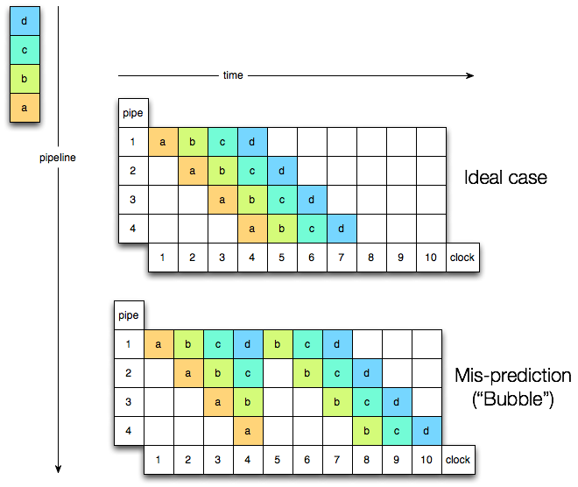
CPU pipeline

Slide 21
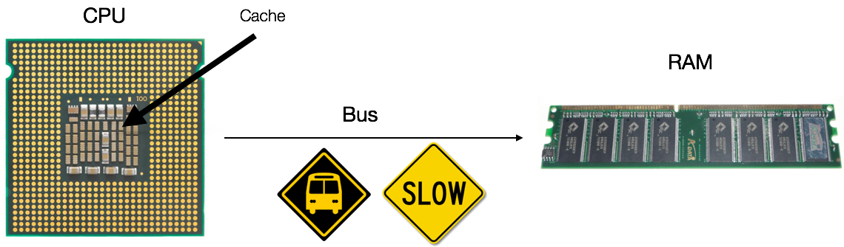
Minimize CPU cache misses
a cache miss costs 10 to 100s cycles depending on the level

Slide 22
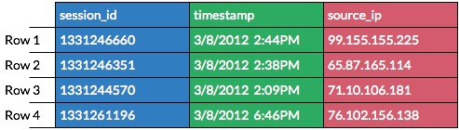
Focus on CPU Efficiency
Cache Locality
Super-scalar & vectorized operation
Minimal Structure Overhead
Constant value access
With minimal structure overhead
Operate directly on columnar compressed data
Traditional
Memory Buffer
Arrow
Memory Buffer

Slide 23
Arrow Messages, RPC & IPC

Slide 24
Common Message Pattern
Schema Negotiation
Logical Description of structure
Identification of dictionary encoded Nodes
Dictionary Batch
Dictionary ID, Values
Record Batch
Batches of records up to 64K
Leaf nodes up to 2B values
Schema Negotiation
0..N Batches
Dictionary Batch
Record Batch
1..N Batches
Record Batch
Record Batch

Slide 25
Columnar data
persons = [{
name: ’Joe',
age: 18,
phones: [
‘555-111-1111’,
‘555-222-2222’
]
}, {
name: ’Jack',
age: 37,
phones: [ ‘555-333-3333’ ]
}]

Slide 26
Record Batch Construction
Schema Negotiation
data header (describes offsets into data)
{
name: ’Joe',
age: 18,
phones: [
‘555-111-1111’,
‘555-222-2222’
]
}
Dictionary Batch
name (bitmap)
name (offset)
name (data)
age (bitmap)
Record Batch
age (data)
phones (bitmap)
Record Batch
phones (list offset)
phones (offset)
Record Batch
phones (data)
Each box (vector) is contiguous memory
The entire record batch is contiguous on wire

Slide 27
Moving Data Between Systems
RPC
Avoid Serialization & Deserialization
Layer TBD: Focused on supporting vectored io
Scatter/gather reads/writes against socket
IPC
Alpha implementation using memory mapped files
Moving data between Python and Drill
Working on shared allocation approach
Shared reference counting and well-defined ownership semantics

Slide 28
Java: Memory Management
Chunk-based managed allocator
Built on top of Netty’s JEMalloc implementation
Create a tree of allocators
Limit and transfer semantics across allocators
Leak detection and location accounting
Wrap native memory from other applications

Slide 29
Language Bindings
Parquet
Arrow
Target Languages
Java
CPP
Python & Pandas
Engines integration:
Many!
Target Languages
Java
CPP, Python
R (underway)
Engines integration:
Drill
Pandas, R
Spark (underway)

Slide 30
Execution examples:

Slide 31
RPC: Single system execution
The memory representation is sent over the wire.
No serialization overhead.

Slide 32
Multi-system IPC

Slide 33
Summary and Future

Slide 34
Where is the bottleneck?
L1 cache reference | 1x
Branch mispredict | 3x
L2 cache reference | 4x
Main memory reference | 100x
Non-volatile Memory | 200x
3D Xpoint Read | 1600x
RDMA Read | 1600x
SSD Read | 16,000x
Spinning Disk read | 3,000,000x
CPU Bound
IO Bound
Sources
- https://people.eecs.berkeley.edu/~rcs/research/interactive_latency.html
- http://www.anandtech.com/show/9470/intel-and-micron-announce-3d-xpoint-nonvolatile-memory-technology-1000x-higher-performance-endurance-than-nand

Slide 35
RPC: arrow based storage interchange
The memory representation is sent over the wire.
No serialization overhead.

Slide 36
RPC: arrow based cache
The memory representation is sent over the wire.
No serialization overhead.

Slide 37
Storage tiering with Non Volatile Memory

Slide 38
What’s Next
Parquet – Arrow Nested support for Python & C++
Arrow IPC Implementation
Arrow RPC & HTTP/2
Kudu – Arrow integration
Apache {Spark, Drill} to Arrow Integration
Faster UDFs, Storage interfaces
Support for integration with Intel’s Persistent Memory library via Apache Mnemonic

Slide 39
Get Involved
Join the community
dev@{arrow,parquet}.apache.org
Slack:
https://apachearrowslackin.herokuapp.com/
http://{arrow,parquet}.apache.org
Follow @Apache{Parquet,Arrow}

